Slide 1

How to Affect Rent Price
Yuefei Chen

Slide 2
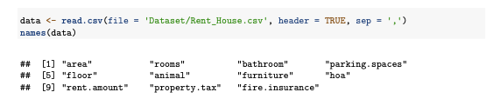
Collection Process
In this dataset, the “area” is the house area. The “rooms” represents quantity of rooms. The “bathrooms” means quantity of bathroom. The “floor” is the floor of each house. It is a character because some of elements are ‘-’ if the elements is unknown. The “animal” means whether accept animals or not. It is a boolean variable. The “parking.spaces” is quantity of parking spaces. The “hoa” is homeowners association tax. The “fire.insurance” is fire insurance. The “property.tax” is property tax. The “furniture” is with furniture or not. The “rent.amount” is rent price.
Notes:
We collect the rent prices and other features from the Brazil in 2020. After cleaning the data, we get the following variables

Slide 3
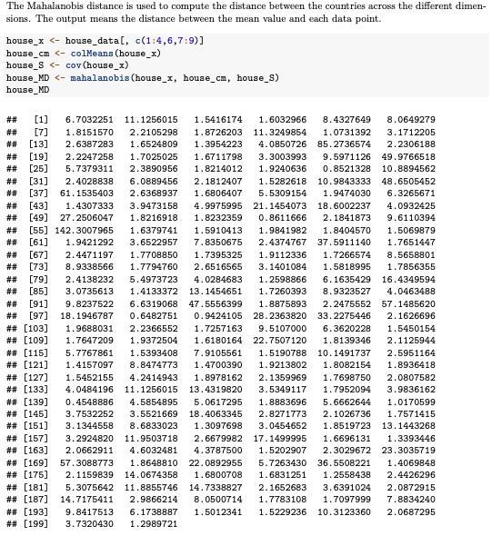
the Mahalanobis distance
Notes:
Since the data is too large. We randomly choose 200 of them as a smaller dataset. The Mahalanobis distance is used to compute the distance between the countries across the different dimen- sions. The output means the distance between the mean value and each data point.

Slide 4
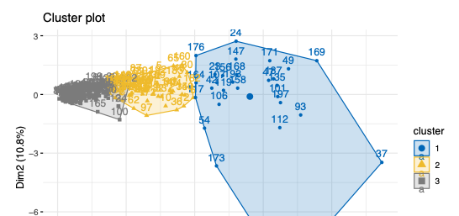
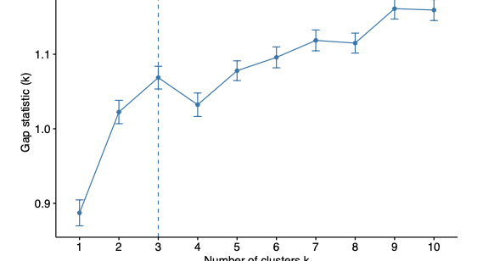
K-means Clusters
The gap statistc plot and cluster plot
Notes:
We can see that in gap statistc graph. K = 3 is a good classification cluster choice. The value is high and shows it can well distinguish different groups or patterns in the data. The data points within each cluster are relatively similar, while the data points between different clusters are relatively different, thus reflecting the intrinsic structure of the data.

Slide 5
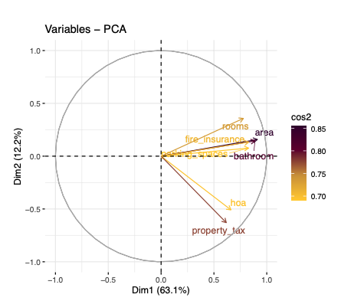
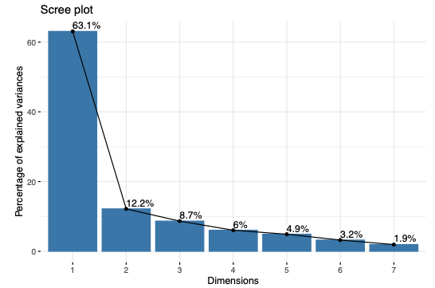
PCA
Notes:
According to the Scree diagram, we can find that there are two PCs have significant performance in percentage of explained variances. Hence, 2 components can be extracted from these variables. The visualization is as follows.

Slide 6
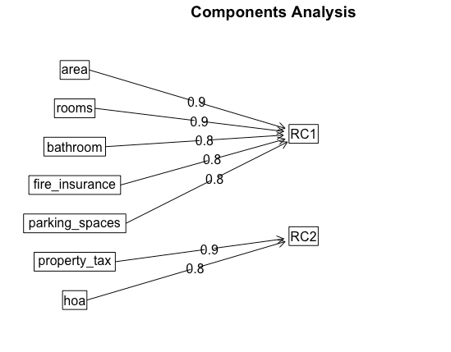
factor analysis
Notes:
7 variables will be transformed into 2 factors. The relationship between RC1 and "area", "rooms", "bedroom", "parking_spaces", "fire_insurance" are 0.9, 0.9, 0.8, 0.8, 0.8. The relationship between RC2 and "hoa", "property_tax"is 0.9, 0.8. The visualization is as follows.

Slide 7
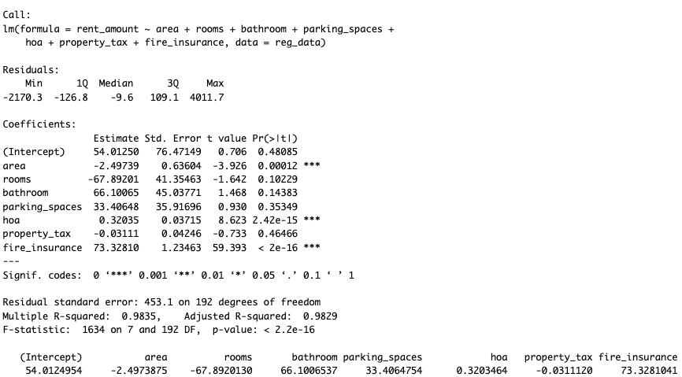
Multiregression model in different forms
Notes:
In the summary of the model, we focus on R squared value, coefficients, and P-value of each coefficient. The R-squared value is 0.9835 and Adjust R-squared value is 0.9829. It shows there is a high proportion of variance in the dependent variable can be explained by the independent variables. The result of coefficient is shown in the following table. P-value result shows that the "area", "hoa", and "fire insurance" are variables which have a significant relationship with the "rent amount" variable.

Slide 8
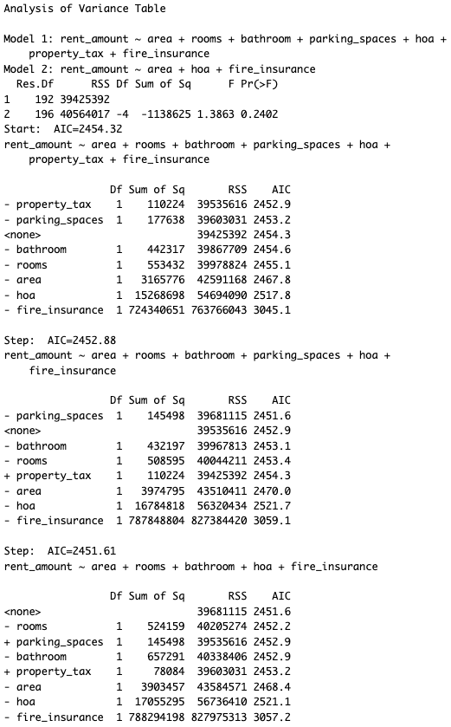
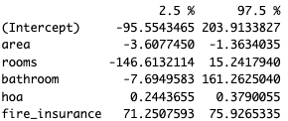
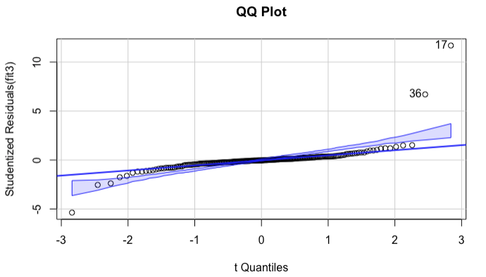
Multiregression model
Notes:
In addition, we use anova to compare full model and reduced model. The result shows that only keeping "area", "hoa", and "fire insurance" does not improve the model performance. Therefore, we use stepAIC to find an optimal model. It contains "area", "rooms", "bathroom", "hoa", "fire insurance".

Slide 9
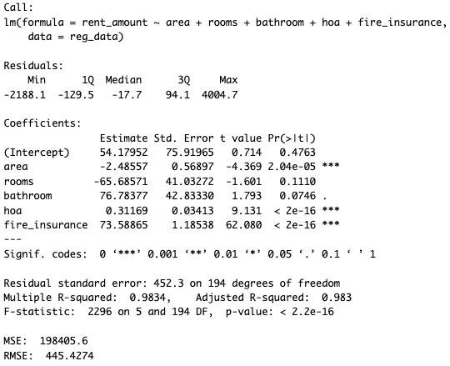
Multiregression model
We set a data point with area = 120, rooms = 3, bathroom = 2, hoa = 0, fire insurance = 50, then the rent amount we predict is 3391.853.

Slide 10
Conclusion
It reveals that extensive utilization of various multivariate analysis (MVA) models to explore relationships between house rental prices and associated features. The analyses incorporated multiple regression models and k-means clustering to interpret the underlying structure of the dataset. Notably, we applied principal component analysis (PCA) and factor analysis to reduce dimensionality and uncover latent variables influencing rental prices.
Significant findings from the regression analysis included the identification of key predictors such as area, number of rooms, and presence of amenities like parking and fire insurance, which were significantly related to rental costs. K-means clustering demonstrated distinct groupings within the data, suggesting variations in housing characteristics that could affect rental prices.

